Slide 1
Production Preparation Process (3P) Workshop
Notes:
NOTE: This module can be used after the 3P Kick-Off Event Presentation or as a stand alone event.
The three-day 3P Kick-off Event introduces 3P as a concept, selects the product or process to be 3P’d and establishes the baseline data and the requirements for the 3P Lab and sets up the Project Charter.
If the project is small enough or the team is experienced in 3P, then this Workshop presentation can be used without a 3P Kick-off event providing the Project Charter has been specified beforehand and adequate preparations have been made to run the Workshop including having a 3P Lab available.

Slide 2

Other Modules In This Series:
5S
Standard Work
Total Productive Maintenance (TPM)
Administrative Lean
Cell Design/ Production Preparation Process (3P)
Kaizen
Kanban
Problem Solving
Poka Yoke Quality Systems
Transaction Process Improvement (TPI)
Cause & Effect Diagram with the Additions of Cards (CEDAC)
Single Minute Exchange of Dies (SMED)
Value Stream Mapping (VSMi®)
Visual Management
Managing Daily Process Excellence
For More Information Please Contact:
Mark DeLuzio, President and CEO
+1.860.234.0915
mark.deluzio@leanhorizons.com
Strategically Creating Value Through the Elimination of Waste

Slide 3
This document contains confidential
and proprietary information owned
by Lean Horizons Consulting, LLC.
Any disclosure, use, copying or
distribution of this information without the express written consent of Lean Horizons Consulting is strictly prohibited.

Slide 4
Ground Rules for Event
Safety first (use personal protective equipment)
Active participation by all
Start and end on time
All electronic gadgets (phones, pagers, etc) turned to “off” or “silent”
Computers to be used only when instructed
Keep an open mind to change
Don’t let “perfect” get in the way of “better”
Notes:
DO: Perform Group Introductions. Or Take two minutes to learn about another person and then 1 minute to present them to the group e.g. name, where were they born, where do they live now, family – married, children, hobbies, personal qualities, position, career, what do they like about work, what do they expect to get from this event.
Pick an ice-breaker or exercise to warm the team up to the event. (Icebreaker Example: Everyone uses their name tent and writes a “Personal License Plate” in which they have 2 minutes to creatively use a total of 7 letters or numbers to tell us something about themselves. Examples “LV2SAIL” OR “DADOV5”
DO: Review Event Ground Rules.
ASK: “Does anyone have any rules they would like to see added?”
ASK: “Does everyone agree to these?”

Slide 5
3P Exercise: Part 1
Objective
Simulate a 3P exercise.
Instructions
Time to Complete
Form teams of 3-7 participants. Each team will be given 10 sheets of paper.
Each member of the team is to draw at least three alternative designs of a paper airplane that will fly for at least 2 seconds from a height of 5’ (1.5m) and that also looks aesthetically pleasing. The key criteria is that the plane can be made quickly and consistently.
Each team is to select the best three designs and construct a prototype of each, test the prototypes against the above criteria and then agree on the final model.
20 minutes
Deliverable
Consensus final design paper airplane
Notes:
SAY: “3P is largely a creative thinking event. Teams are challenged to keep the creative juices flowing as we strive to achieve breakthrough designs and processes. So it is appropriate that we kick the event off with a 3P style creative, team-building exercise. This is a competitive exercise and teams are competing against each other.”
MATERIALS REQUIRED: 1 stopwatch as many sheets of 8.5x11” (or A4) paper per team as required. (Optional: Colored pencils)
DO: Read the instructions aloud with the class on the slide. Have the materials prepared and the tables already assembled to facilitate working in small groups.
DO: Encourage the teams to think about how things in nature achieve flight. Birds, flying squirrels, air borne seeds etc.
DO: Ensure that they follow the 3P process of: i) individual drawn designs, ii) selecting the top three, iii) prototyping and then iv) final selection on the one best solution. Also ensure it is clear that they have 20 minutes in their teams to come up with their final airplane design and test it.
NOTE: Allow the class to come up with their own method for how to determine the best design. Do not be too directive here. Also you may be asked what the criteria for “aesthetically pleasing” is. Just say that “it must look like an airplane or other type of aircraft (no floating flat pieces of paper!)”. Either select a “Customer” or you act as Customer and be the ultimate judge. The Customer can not participate in the team exercises.

Slide 6
3P Exercise: Part 2
Objective
Simulate production of the consensus design from the previous exercise.
Instructions
Time to Complete
In the same teams, you will be given 15 minutes to plan production and forecast how many paper airplanes your team can build in a 2 minute period and how much profit you can make.
Costs = $1 for each sheet of paper, $10 for each team member and $5 for each reject airplane.
Income = $5 per completed plane (approved by customer)
At the end of the production run count your finished airplanes and calculate your profit. Planes must be of the same quality as the prototype and fly for 2 seconds.
30-45 minutes
Deliverable
All results compared and winning team announced.
Discuss lessons learned
Notes:
DO: Read aloud the instructions on the slide for Part 2. Ensure all teams understand they are to build as many of their chosen design of airplane in 2 minutes as they can.
DO: Provide 15 minutes for each team to plan and test their production method and forecast how many paper airplanes the team can build in a 2-minute period and how much profit they will make. Costs and income are indicated on the slide. Write their forecasts on a flip chart or board.
DO: Ensure they understand that the planes must be of the same quality as the prototype and will be examined upon completion by the customer (Observer).
DO: Run the production exercise for 2-minutes. The Customer should be keeping time and taking notes. When the production run is completed, the Customer must inspect the planes to be the same quality as the prototype and remove any inferior planes. Remember to keep a tally of these for later when calculating costs.
DO: Ask each team in turn to select one member to fly each plane from approximately 5’ (1.5m) height. The Customer decides if the plane has passed the 2-second test and failed planes are again deducted from the final count.
DO: Score the teams using the following table, compare the profits and identify the winning team.
SCORE TABLE
Team Predicted Profit Total # Produced # Rejects Final Profit
Team 1
Team 2
etc
DISCUSSION QUESTIONS TO ASK:
Was the final result different from the forecast? Why?
Was there any conflict in the group?
Did certain people take on or accept roles within the team?
Was quality a concern?
Did everyone participate in the discussion and decision-making process?
DO: Relate how we will see elements of this exercise in our 3P event.

Slide 7
Goal of 3P
Develop and implement a new product/process with the highest quality, lowest cost, in the shortest time
PROCESS STEP 1
PROCESS STEP 2
PROCESS STEP 3
PROCESS STEP 4
Leadership
Awareness/ Commitment
3P Kick-Off
3P Workshop
Implement
Apply
learning
to next 3P
Notes:
DO: Introduce the notion of Deming’s PDCA in relation to 3P as an iterative process of creative divergence and constructive convergence and refinement.
This Introduction is a review of 3P to remind delegates of what was covered in the Kick-off presentation or, if experienced in 3P, to revise and reorient them.

Slide 8
3P Roadmap to Success
PROCESS STEP 1
PROCESS STEP 2
PROCESS STEP 3
PROCESS STEP 4
Leadership Awareness/ Commitment
3P Kick-Off
3P Workshop
Implement
Apply
learning
to next 3P
Attend 3P Executive Overview
Readiness Assessment
Prerequisites
Commitment to 3P process
3P Overview Training
Define the requirements
Create 3P Lab
Prepare Event Charter & Plan
Detailed 3P Training and Exercises
Application of 3P Methodology to Design/Process
Creation of Implementation Plan
Plan equipment, fixtures, tooling
Develop support systems
Install and qualify
Create Standard Work

Slide 9
3P Roadmap to Success
PROCESS STEP 1
PROCESS STEP 2
PROCESS STEP 3
PROCESS STEP 4
Leadership Awareness/ Commitment
3P Kick-Off
3P Workshop
Implement
Apply
learning
to next 3P
Define
Objectives/
Needs
Study and
Analyze
Examples
from
Nature, etc.
Sketch and
Evaluate
Alternative
Process
Steps
Build,
Present, and
Select
Process
Prototypes
Develop Plan
to
Implement

Slide 10
3P Workshop Structure
Define
Objectives/
Needs
Study and
Analyze
Examples
from
Nature, etc.
Sketch and
Evaluate
Alternative
Process
Steps
Build,
Present, and
Select
Process
Prototypes
Develop Plan
to
Implement
Identify Voice of the Customer and current performance metrics
Select target, write charter, pick the team
Review product
Define key functions
Find examples from Nature, etc.
Define 16 Catch Phrases
Sketch 7 Alternatives for each process step
Apply 16 Catch Phrases
Evaluate and Combine
Prototype Top 3 Alternatives
Refine & Evaluate
Scale up Top Alternative
Plan equipment, fixtures, tooling
Plan support systems
Prepare implementation plan
Present

Slide 11
3P Workshop Agenda
Day | Key Learnings | Daily Deliverables
1 | Process Analysis Key Functions | Process diagram
2 | Back to basics/Nature 16 Catch Phrases | Function Sketches 7 Alternatives (for each process step)
3 | Visual Creativity Selection Criteria | Evaluate 7 Mockup
4 | Physical Limits/Interfaces Duration & Effort | Refine & Combine/Select Top 1 Process @ Glance Implementation Plan
5 | Prepare for Team Final Report-Out | Final Report-Out to Management
Notes:
NOTE: Make any modifications or inclusions/deletions to Workshop event as required by nature of 3P event.

Slide 12
3P Defined
Production Preparation Process (3P) is a team approach to concurrent production process and product design that delivers:
  Highest customer Quality
  At the lowest product and capital Cost
  With better Safety, Ergonomics and Less Environmental Impact
  For the required Volume
  Able to Flex to volume changes
  On Time and in the shortest project Lead Time

Slide 13
3P Defined
3P is an advanced lean tool typically used by organizations that have experience with other lean methods
3P focuses on eliminating waste by building quality into the process through product and process design
3P starts with a clean product development slate to rapidly create and test potential product and process designs that require the least time, material, and capital resources
3P involves a diverse team in a multi-day creative process to identify several alternative ways to meet the customer's needs
Notes:
SAY: “3P is an advanced lean tool typically used by organizations that have experience with other lean methods
Kaizen and other lean tools take a production process as a given and seek to make improvements, 3P focuses on eliminating waste through product and process design.
3P seeks to meet customer requirements by starting with a clean product development slate to rapidly create and test potential product and process designs that require the least time, material, and capital resources.
3P involves a diverse group of individuals in a multi-day creative process to identify several alternative ways to meet the customer's needs using different product or process designs.
Eliminate the ‘Three D’s’ – dirt, difficult, dangerous”

Slide 14
Goal of 3P
Least waste by integrating the ‘4M’s’ (Man, Material, Machine, Methods) of production into a good flow
Eliminate Muda (waste), Mura (variability), Muri (overloading)
Eliminate the ‘Three D’s’ – dirt, difficult, dangerous
Build quality into the process with Poka-yoke & Jidoka

Slide 15
When to use 3P – Top 5 Reasons
New product development. Educate designers in Lean as early as possible.
Capital expenditure approval. Don't sign a Cap Ex without first doing 3P.
Product design changes. Don’t approve changes without a 3P review.
Significant changes in volume. If you didn't design the process Lean, here's a second chance.
Relocation of processes. If you're going to pick it up and move it anyway, you might as well Lean it out first.

Slide 16

Benefits
Increased sales – extended product life cycle, early adopters increased early stage pricing
First to market – increase chances of competitor lock-out
Enhance market image as innovative producer
Improved product performance
Reduced production cost – product and capital required
Reduced development costs
Increases profitability
Notes:
SAY: “Product performance can be enhanced in two ways; 1) by involving multidisciplinary teams early, an improved solution can be found, 2) by having a fast development process, development can afford to wait for improved or cheaper technology and still make it to market on time.
Lower production costs do not naturally follow as typically 2X effort leads to ½ development time. However more focused effort and fewer iterations and mistakes can lead to improved development efficiency and lower development costs.”

Slide 17
Prerequisites for successful 3P
Organizational lean maturity
Strategic alignment and VOC
Follow kaizen guidelines
Cross-functional associate involvement
Adequate mechanical and design capabilities
Establish 3P Lab with supplies and staff
Leadership sponsorship
Willingness to be revolutionary

Slide 18

Obstacles to Product Development
Chaotic work environment – constant interruptions
Resources spread too thinly – resource bottlenecks
Failure to prioritize projects/tasks
Poor communication and lack of multi-disciplinary team approach
Poorly defined product requirements and constant changes
Lack of a formal design process with checkpoints
Late consideration of manufacturability
Lack of effort in concept development and evaluation

Slide 19
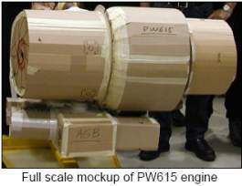
3P Principles – overarching logic of 3P
Kaikaku - rapid revolutionary, not incremental evolutionary change
Cross-functional team based creative design
Moonshine: sketch, model, simulate, prototype, scale up
Diverge then converge, then repeat
Catch Ball and refine
Design in quality, design out waste

Slide 20
The Four Phases of 3P
VOC/spec’s
Part Numbers
Drawings
Samples
Standards
Interfaces
Volumes
Ramp
Takt Time
Process Steps
Target Costs
7 Alternatives
16 Catchphrases
Simulations
Model Lab
Selection
Flow Chart
Takt Time
Cycle Time
Equipment Plan
Process Capacity
Standard Work
Standard Layout
Launch Phase
Information Phase
Creative Phase
Definition Phase
3P Kickoff
3P Event
3P Implementation
Notes:
SAY:”3P is an iterative process of creative divergence and constructive convergence and refinement through four phases: Information, Creative, Definition and Launch.”

Slide 21
Product and Production Interaction
A. Product Planning
1. Production Planning
Constant Interaction Between Paths
B. Function Definition
2. Process Alternatives
C. Product Alternatives
3. Refine and Test
D. Refine and Test
5. Detail Production Process
4. Trials: Design & Process
E. Detail Design
6. Equipment Planning
9. Volume Production
8. Process Pilot
7. Equipment Procurement
10. Installation
11. Service
12. End of Life
Notes:
SAY: “This is a Concurrent Engineering method and is to illustrate that product design and production design need to run hand in hand with constant interaction between the two. This is very relevant to 3P. The traditional method is to design the product in isolation and throw it over the wall to the production department to make the best of it. Often product designers do not understand manufacturing and vice versa.”
SAY: “It is the interaction of product designers and production engineers that will achieve the best possible solution when using the 3P method.”

Slide 22
5 Steps to 3P
Define Product/Process Design Objectives/Needs
Study Alternatives by Diagramming and Finding and Analyze Examples from Nature or other sources
Sketch and Evaluate Alternative Process Steps
Build, Present, and Select Process Prototypes
Develop Implementation Plans
Notes:
3P FIVE STEP CREATIVE PROCESS
1. Define Product or Process Design Objectives/Needs
The team seeks to understand the core customer needs that need to be met. If a product or product prototype is available, the project team breaks it down into component parts and raw materials to assess the function that each plays.
2. Study Alternatives
Diagramming: A fishbone diagram or other type of illustration is created to demonstrate the flow from raw material to finished product. The project team then analyzes each branch of the diagram (or each illustration) and brainstorms key words (e.g., roll, rotate, form, bend) to describe the change (or “transformation”) made at each branch.
Find and Analyze Examples in Nature: The project team then tries to find examples of each process keyword in the natural world. For example, forming can be found in nature when a heavy animal such as an elephant walks on mud, or when water pressure shapes rocks in a river. Similar examples are grouped and examples that best exemplify the process key word researched to better understand how the examples occur in nature. Here, team members place heavy emphasis on how nature works in the example and why. Once the unique qualities of the natural process are dissected, team members then discuss how the natural process can be applied to the given manufacturing process step.
An alternative comparison method is to ask how other industries solve similar problems. e.g. how food processing companies eliminate contamination to reduce mix to mix contamination in other processing industries or how Automotive companies solve similar problems found in the Aerospace industry and visa versa.
3. Sketch and Evaluate the Process
Sub-teams are formed and each sub-team member is required to draw different ways to accomplish the process in question. Each of the sketches is evaluated and the best is chosen (along with any good features from the sketches that are not chosen) for a mock-up.
4. Build, Present, and Select Process Prototypes
The team prototypes and then evaluates the chosen process, spending several days (if necessary) working with different variations of the mock-up to ensure it will meet criteria.
Hold Design Review: Once a concept has been selected for additional refinement, it is presented to a larger group (including the original product designers) for feedback.
5. Develop Project Implementation Plan
If the project is selected to proceed, the team selects a project implementation leader who helps determine the schedule, process, resource requirements, and distribution of responsibilities for completion.

Slide 23






3P Process
1 – Leadership 3P Awareness | 2 – Select target area and team | 3 – Collect data
4 – Train Team | 5 – Design Criteria | 6 – 3P Lab

Slide 24






3P Process
7 – Each team member individually draws 7 Alternatives. | 8 – Team gathers to group and evaluate ideas. Selects the top 7. | 9 – Team moonshines the 7 Alternatives.
10 – Team evaluates each Alternative. Selects the top 3. | 11 – Team moonshines the top 3 Alternatives. | 12 – Team selects Top Alternative.
7
7
7
7
7
7
7
7
3
1

Slide 25
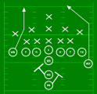




3P Process
13 – Team refines Top Alternative. | 14 – Team completes Process At A Glance form for Top Alternative | 15 – Team prepares Implementation Plan.
16 – Present to Leadership. | 17 – Select builder & prepare fixture and tooling drawings. | 18 – Install, qualify, ramp up.
Key Actions

Slide 26
Define Needs and Objectives
Needs
and Objectives
Examples
from Nature etc.
Sketch and
Evaluate
Alternatives
Prototype
Plan to
Implement
Objectives:
Review team charter and pre-event data collection
Complete Muda walk and observation of current process/design
Complete “before” video and take digital photos
List issues for safety, ergonomics, quality, delivery, cost
Review results of interviews with key personnel
Brainstorm and complete Affinity Diagram process
Notes:
DO: Review chapter objectives.
NOTE: Defining Needs and Objectives is covered in detail in the 3P Kick-off event. This slide is a review of that information or if this is a stand alone event this information can be collected now.

Slide 27
Exercise: Review Team Charter
Needs and Objectives
Objective
As a team, review the event charter.
Instructions
Time to Complete
Review the event charter and validate event objectives and project boundaries.
20 minutes
Deliverable
Make any necessary modifications to charter.

Slide 28
What is “Waste”?
Needs and Objectives
Types of Waste | Descriptions
1. Muda | Any activity that consumes resources without creating value for the customer
2. Mura | Unevenness in a process; for example an uneven work pace causing people to hurry and wait
3. Muri | Overburdening, overloading, or stressing of resources (such as people or equipment)
Notes:
DO: Explain the three types of waste that originate from the Japanese.

Slide 29
The Content of Work
Needs and Objectives
Value Added Work - maximize
  The part of the job the customer values
Enabling Waste - minimize
  Work that does not add value but is necessary under the current operating conditions
Obvious Waste - eliminate
  Work that does not add value and is not necessary
Notes:
NOTE: A simple exercise to illustrate this slide is to use a use a pen to mark a small 1” circle on a board or flipchart.
SAY: “Let’s pretend that a customer orders a circle.”
Start by fetching the pen from a few paces away.
Pull the cap off and draw a circle.
ASK: ”What is Value Added?” Ans.=Drawing the circle (emphasis that that is what the customer ordered and is willing to pay for)
ASK: “What is Obvious waste?” Ans.=Walking to fetch the pen.
ASK: “What is Enabling waste?” Ans.=Taking the cap off (necessary because pen would dry out if not replaced)

Slide 30
The Eight Wastes Defined
Needs and Objectives
Wastes | Definition
Defects | Process steps that result in scrap, rework or re-processing.
2. Over Production | Producing more product than is required at the current time.
3. Waiting | Periods of inactivity while waiting for the next process step to begin.
4. Non-Utilized Talent | Unused creativity and underutilized human capital.
5. Transportation | Product moving from person to person or between locations.
6. Inventory | Unprocessed or partially processed materials, or undelivered finished goods.
7. Motion | Excessive movement by people or machines.
8. Extra Processing | Unnecessary work beyond what is required to meet customer requirements.
Notes:
Mnemonics: DOWNTIME
DO: Ask the class to provide examples of the 8 wastes. Capture their answers on a chart paper. The participants can write the answers in their workbooks.

Slide 31
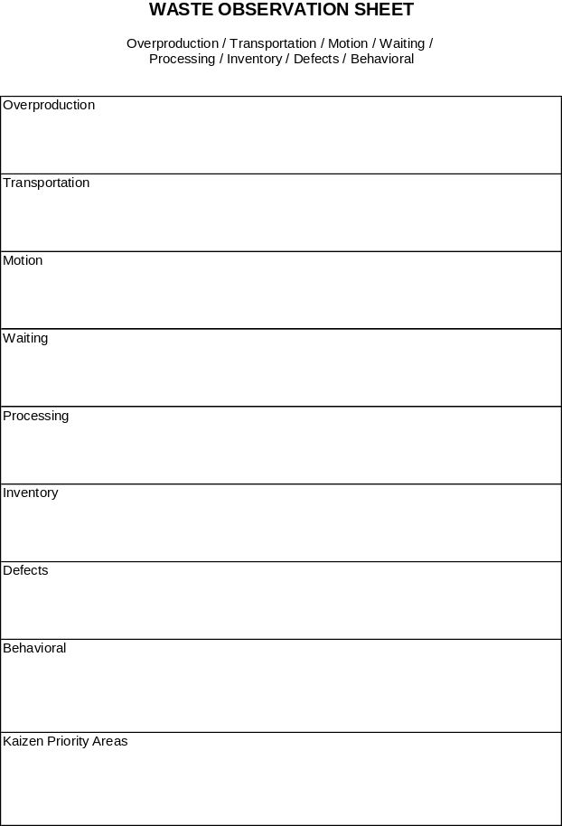
Muda Walk Observation
Needs and Objectives
Examine waste closely
Independently collect examples
Compare notes
Prioritize
Save for comparison to design alternatives

Slide 32
Example Data to Review
Needs and Objectives
Part Numbers
Drawings
Samples
Time: process time, lead time and value added time
Changeover times
Typical batch sizes
Quality (process outputs)
Number of Poka Yokes
Reliability
Cost Targets
Ramp schedule
Delivery peak volume
Scalability (volume fluctuations)
Takt time
Replenishment times
Standard WIP
Layouts and people
QFD or Strategic Deployment
Process steps or maps
Value Stream Map

Slide 33
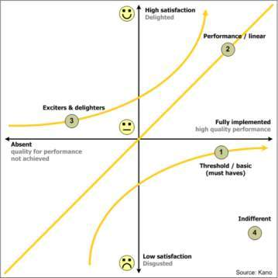
Review VOC
Needs and Objectives
A detailed understanding of the customer’s requirements
A common language for the team going forward
Key input for the setting of appropriate design specifications for the new product or service
A highly useful springboard for product & process innovation.

Slide 34

Review results of interviews regarding current process/design
Needs and Objectives
Operators
Supervisors
Inspectors
Managers
Material Handlers
Maintenance
Tech Support

Slide 35
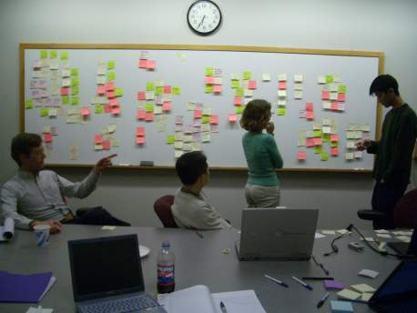
Complete Affinity Process
Needs and Objectives
Make visible the problems we have learned about in this data review
Notes:
SAY: “Notice the time on the clock, that’s 6:35pm – just getting started.”

Slide 36
Exercise: Take Muda Walk
Needs and Objectives
Objective
As a team, observe the process, dissect the product
Instructions
Time to Complete
Complete Muda Walk and observation of current process or design
Observe and document repetitive builds (multi-cycle analysis)
Complete Motion Analysis (Eliminate, Combine, Modify, Simplify)
Complete “Before” Video
Interview stakeholders
Complete Affinity Diagram of all opportunities
Provided by facilitator
Deliverable
List issues observed for safety, ergonomics, quality, delivery, cost.
Complete the Affinity Diagram.

Slide 37
Exercise: Management Review
Needs and Objectives
Objective
Management review of conclusions from the data and finalized charter
Instructions
Time to Complete
Management review of conclusions from the data and finalized charter
20 minutes
Deliverable
Approval of charter and event direction.

Slide 38
Complete Diagram of the Current Process/Design
Needs
and Objectives
Examples
from Nature etc.
Sketch and
Evaluate
Alternatives
Prototype
Plan to
Implement
Objectives:
Decide on diagram(s) format
Complete diagram process
Review decision matrix and adjust criteria accordingly
Identify and rank opportunities
Summarize key opportunities
Assign sub-teams to begin 3P cycles
Notes:
DO: Review chapter objectives.

Slide 39
Diagrams
Needs and Objectives
Points | Descriptions
Fishbone Diagram | 4 M’s: Man, Material, Method, Machine
Process Fishbone | Sequence of build with components, and processes
Exploded Assemble | Illustration of all assemblies
Design Diagram | The whole system
Process Map | The whole system or sub-process

Slide 40
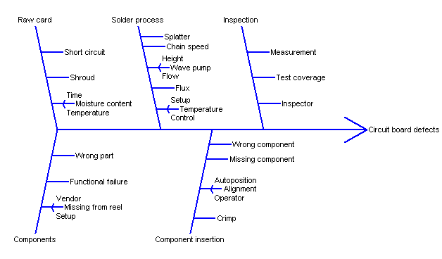
Process Fishbone Diagram Example
Needs and Objectives

Slide 41
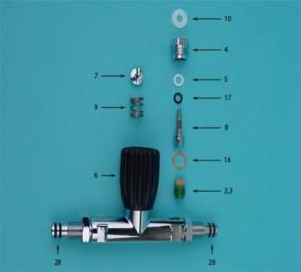
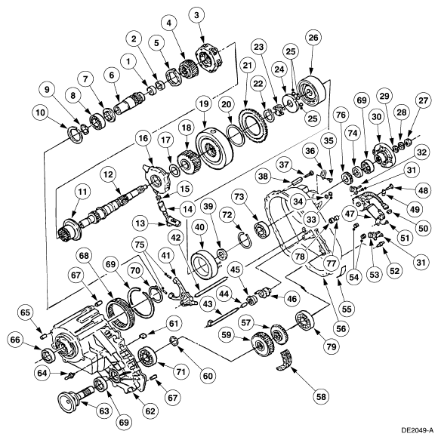
Exploded Assembly
Needs and Objectives
Use drawings and exploded views to visualize product or process

Slide 42
Process 3P Diagram Example
Needs and Objectives
Operation
From:
Raw Material
STANDARD WORK SHEET
Part No.
123-A
Sequence
To:
Assembly
Part Name:
Bracket
Tap
Drill
Mill
Raw
Material
+
+
+
Grind
5
4
3
2
1
6
+
7
Finished
Goods
Assembly
Test
Pack
Quality Check
Safety Precaution
Standard WIP
# Pieces WIP
TAKT Time
Cycle Time
+
4
77”
70”

Slide 43
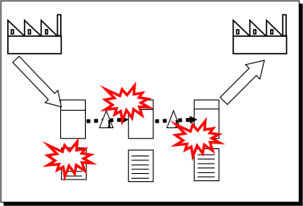

Value Stream Map and Process Map
Needs and Objectives
Detailed graphical depiction of a
manufacturing or business process
Used to identify specific improvements
Incorporates decision loops within the
process
VALUE STREAM MAP
High-level snapshot of end-to-end business
Used to identify where opportunities for
improvement exist
Does not incorporate decision loops
Notes:
SAY: “A Value Stream Map is the “30,000-foot” view of the process. A Process Map is a tool that would take just one process box from a Value Stream Map, and explode that process into it’s detailed steps.”

Slide 44
Example Process Mapping Symbols
Needs and Objectives
Operation
A Step in the process
that adds value.
Transportation
To move from one place to
another. (Not part of an
operation or inspection.
Measurement
To inspect, verify, count,
examine, gage for quality
or quantity.
Transmission
To send information by
electronic means.
Storage
To hold for later use.
(I.e., in a queue).
Decision
A step in the process where
a change in the flow may
occur.
Delay
To wait for the next operation.
(I.e., in a queue).
No value added.

Slide 45
Break into manageable projects
Needs and Objectives
Complex products and processes may need to be segmented due to limitations in current technology, space, cost, ‘laws of nature’
Might initially focus on final assembly, then later look at components
3P Design Team needs to revisit the Charter and make any adjustments to scope and prioritize sequence
Risk of sub-optimization – need to Catch Ball up and down stream

Slide 46
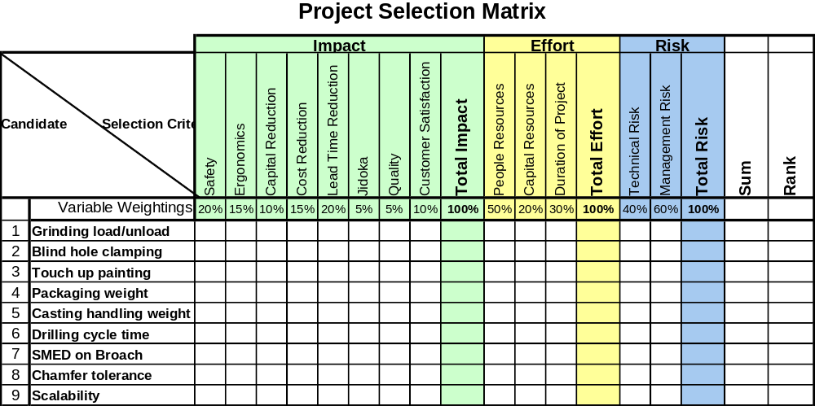
Prioritize Opportunities
Needs and Objectives
Prepare a Decision or Pugh Matrix; adjust criteria & weightings
Rank impact, effort, complexity risk
Or, dot vote or other method to identify greatest opportunities

Slide 47
Summarize key opportunities
Needs and Objectives
Prioritize which process steps or components need the most work
Create sub-teams to begin 3P cycles on the prioritized process steps and components

Slide 48
Exercise: Diagrams
Needs and Objectives
Objective
Complete diagram process to identify and prioritize opportunities.
Instructions
Time to Complete
As a team, determine which diagram(s) best suits the project and complete the diagram(s). Rank and prioritize 3P opportunities.
Determine 3P sub-teams and assign 3P projects to the sub-teams.
Determine # of 3P cycles needed for event.
Provided by facilitator
Deliverable
Completed diagrams indicating focus priorities.

Slide 49
3P Creative Thinking Process
Needs
and Objectives
Examples
from Nature etc.
Sketch and
Evaluate
Alternatives
Prototype
Plan to
Implement
Objectives:
Identify key functions of the assignments from the diagram
Identify key words that describe each function
Brainstorm and draw examples from nature or other source of each function
Group like ideas
Present final ideas
Notes:
DO: Review chapter objectives.

Slide 50
3P Cycle
Examples from Nature
Each team member individually draws 7 Alternatives. | Team gathers to group and evaluate ideas. Selects the top 7. | Team moonshines the 7 Alternatives.
Team evaluates each Alternative. Selects the top 3. | Team moonshines the top 3 Alternatives. | Team selects Top Alternative.
7
7
7
7
7
7
7
7
3
1

Slide 51
Thinking Outside The Box
Examples from Nature
Objective
Stimulate the team to think laterally about solutions.
Instructions
Time to Complete
Given the handout “Join the Dots”, follow the instructions to join all the dots with the number of lines stated.
10 minutes
Deliverable
Review how this has parallels to creative design.
Notes:
DO: Either print out copies of the three Dot Puzzles in Join-the-Dots.ppt or use blank paper and get the participants to make their own Dot matrices and solve the puzzles.
Show the first slide of Join-the-Dots.ppt and then give the participants 2 minutes to try to join the dots with the required number of consecutive lines. For the first one this is 4 lines.
Then reveal the answer. Reinforce the idea of thinking outside the ‘self limiting’ box in order to get a solution.
Then show them the 12 Dot puzzle and ask them to complete it with 5 lines.
Reveal the answer and then repeat for the 16 dot puzzle.
Finally show the alternative solution to the 9 dot matrix at the end.

Slide 52
Identify key functions
Examples from Nature
Determine the key functions of the process to be studied from the diagram(s)

Slide 53
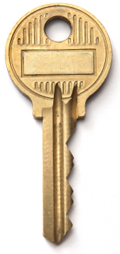
Identify key words for each function
Examples from Nature
Guide
Clamp
Swivel
Oscillate
Lock
Rigidity
Spin
Press
Bond
Turn
Roll
Brake
Drill
Shear
Fasten
Slide
KEY WORDS

Slide 54
Exercise: Determine Function
Examples from Nature
Objective
Determine key functions.
Instructions
Time to Complete
Using the example provided on the following page, determine the key functions for the product.
Answer: how does it add value to the customer?
Determine customer needs.
15 minutes
Deliverable
Report out key functions, value added, and customer needs.

Slide 55
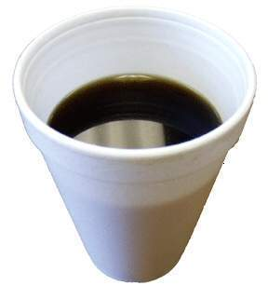
Define Function Exercise
Examples from Nature
How would you describe the product: Styrofoam cup
What does it do? Name the features or characteristics. How does it add value to the customer? List the customer needs.
Verb-Noun Functions
Notes:
NOTE: Features include: convex interior, ridge for stacking, base, cup walls
Functions include: hold liquid, stack cup, insulate liquid, lift base, etc

Slide 56







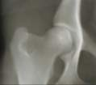
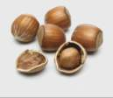



Back to Nature Examples
Examples from Nature
Move
Attach
Cling
Shear
Spin
Adhere
Grip
Hinge
Buoy
Encapsulate
Crawl
Separate
Nature has spent millions of years refining these phenomena

Slide 57
TRIZ – 40 Principles
Examples from Nature
Segmentation
Taking out or extraction
Local quality
Asymmetry
Merging / Consolidation
Universality
Nested doll
Anti-weight
Prior counteraction
Prior action
Cushion in advance
Equipotentiality
The other way round
Spheroidality – Curvature
Dynamics
Partial or excessive action
Another dimension
Mechanical vibration
Periodic action
Continuity of useful action
Rushing through
Blessing in disguise
Feedback
Intermediary/Mediator
Self-Service
Copying
Cheap short-living objects
Replacement of mechanical system
Pneumatics and hydraulics
Flexible membranes and thin films
Porous materials
Color change
Homogeneity
Discarding and Recovering
Parameter Change
Phase transition
Thermal expansion
Accelerated oxidation
Inert atmosphere
Composite materials
Select key words and features from the 40 Principles
Notes:
DO: Pass out TRIZ Handout.
SAY: “TRIZ is a Russian acronym for “The theory of Inventive Problem Solving”
Developed by G Altshuller et al from studying over 400,000 patents and how inventors solved problems.
Read handout on Triz 40 Inventive Principles.dot with examples and explanations.
Use the Contradiction Matrix.xls to help select which principles to use.

Slide 58
Other Solution Sources
Examples from Nature
Competitors
  Copy, adapt and improve
Other industries
  Food vs. process
  Auto vs. Aero
Pattern Breaking tools
  Reverse assumptions, forcing associations, making comparisons, other points of view, blue sky
Study the way others have solved things and list the key words for each function

Slide 59
Exercise: Creative Thinking
Examples from Nature
Objective
Begin the 3P Creative Thinking Process.
Instructions
Time to Complete
In the sub-teams, complete the following activities:
Identify Functions from the diagrammed opportunities
Identify Key Words and principles for each Function
Each team member draws 7 examples of each key word or principle as found in nature or other
Present and group like examples with sub-team.
Report final results to rest of class.
Provided by facilitator
Deliverable
Report out results from creative thinking exercise.
Notes:
SAY: “Why 7? The answer I was given is “because 6 is too few and 8 is too many” from my Japanese Sensei!”

Slide 60
16 Catch Phrases of 3P
Needs
and Objectives
Examples
from Nature etc.
Sketch and
Evaluate
Alternatives
Prototype
Plan to
Implement
Objectives:
Identify the purpose of the 16 Catch Phrases
Define each of the 16 Catch Phrases
Review the Muda Walk Worksheet
Capture examples and non-examples of the 16 Catch Phrases
Notes:
DO: Review chapter objectives.

Slide 61

Purpose of 16 Catch Phrases of 3P
Sketch and Evaluate Alternatives
The 16 Catch Phrases of 3P are used as guidelines for designing processes according to Lean manufacturing principles of Takt, Flow, Pull, and Jidoka.

Slide 62
16 Catch Phrases
Sketch and Evaluate Alternatives
Production preparation should be lightning fast
Build & layout equipment for smooth material flow
Use additive equipment
Build products and equipment that is easy to set up
Make equipment easy to move
Use multi-purpose equipment
Make operator work stations narrow
Layout equipment for ease of operator movement
Eliminate wasted machine cycle time
Build equipment for small, swift flow lines
Use short, vertical flow lines
Build equipment for one-piece pull
Build in quick changeover
Link machines for smooth loading and unloading
Use multiple lines & untangled flows
Spiral upwards to Jidoka
Notes:
1. Production preparation should be lightning fast. Avoid over planning, use what you have, act now.
2. Build & layout equipment for smooth material flow. Flow like a river, not like a dam.
3. Use additive equipment. Buy many speedboats instead of one tanker.
4. Build products and equipment that is easy to set up. Design in the separation of internal and external tasks.
5. Make equipment easy to move. No roots, no vines, no pits. Put wheels on everything.
6. Use multi-purpose equipment. Simple, "just fast enough" machines that perform one function well.
7. Make operator work stations narrow. Town houses, not ranch houses.
8. Layout equipment for ease of operator movement. Remove obstruction to smooth human motion.
9. Eliminate wasted machine cycle time. Design out 'air cutting' and minimize machine movements.
10. Build equipment for small, swift flow lines. Enable Standard Work (Takt, Work Sequence, SWIP).
11. Use short, vertical flow lines. Vertical = advancing process flow, horizontal = functional.
12. Build equipment for one-piece pull. Machine level. This is probably the most critical one.
13. Build in quick changeover. Design in SMED at the machine level.
14. Link machines for smooth loading and unloading. Line stops when WIP on the line is "full work".
15. Use multiple lines & rectified flows. 'Rectified' is an odd term, electrical engineers will get it.
16. Spiral upwards to Jidoka. There are 5 steps to Jidoka, which should be pursued a step at a time.

Slide 63
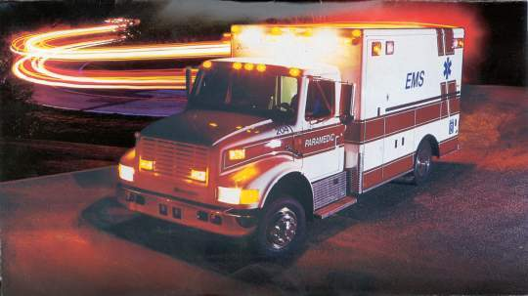
1. Production Preparation should be lightning fast
Sketch and Evaluate Alternatives
From Concept to Production
Avoid over planning, use what you have, act now

Slide 64
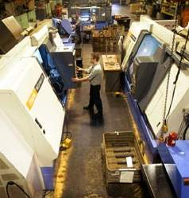
2. Build & layout equipment for smooth material flow
Sketch and Evaluate Alternatives
Use Lean Flow techniques – no waste, cells, Kanban Flow like a river, not like a dam

Slide 65


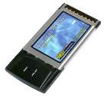
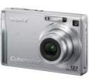
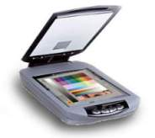

3. Use additive equipment
Sketch and Evaluate Alternatives
Buy many speedboats instead of one tanker

Slide 66
4. Build equipment that is easy to set up
Sketch and Evaluate Alternatives
Change-over Flowing gap
Old product
New product
5
4
5
4
A
3
F
3
2
1
2
Design in the separation of internal and external tasks
5
4
4
B
3
E
3
1
2
1
2
5
4
5
C
D
3
1
2
1
2
Notes:
NOTE: This principle refers to building lines and equipment that can produce multiple products with minimal setting-up.
Also products can be designed to minimize set-up time, such as standard hole sizes, to fit same jig etc.
Use the principles of SMED to remove as much set-up work as possible to be external to the machine cycle. Any set-up work inside the cycle time is internal time.

Slide 67
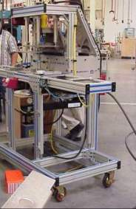

5. Make equipment easy to move
Sketch and Evaluate Alternatives
No roots, no vines, no pits, put wheels on everything
Notes:
SAY: “Don’t fasten things down, make it easy to move things.
Don’t have fixed service locations and lots of wires and pipes. Use flexible pick-ups, short wire runs and make it ‘plug and play’.
Don’t put machines in pits, buy machines that stand flat and can be moved.”

Slide 68
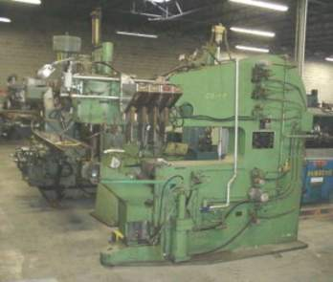
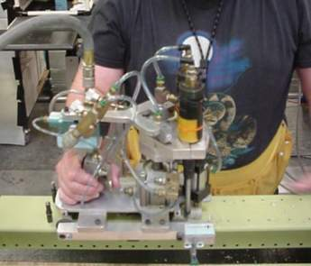
6. Use multi-purpose equipment
Sketch and Evaluate Alternatives
Gem Core Drivematic, Cost $297,000
3P ‘Moonshine’, Cost $7,300
Simple, "just fast enough" machines that perform one function well

Slide 69



7. Make operator work stations narrow
Sketch and Evaluate Alternatives
Fishbone Line
U-Line
Ranch style - Wide and Shallow
Principle of Verticality
Reduced Footprint
Reduced Walking
1step - station to station
Townhouse – Narrow but Deep
Town houses, not ranch houses
Notes:
SAY: “Principle of verticality means select machines that have a small footprint but may be tall.”

Slide 70

8. Layout equipment for ease of operator movement
Sketch and Evaluate Alternatives
Fixed Layout
Flexible Layout
Can change manning to suit demand.
Remove obstruction to smooth human motion

Slide 71
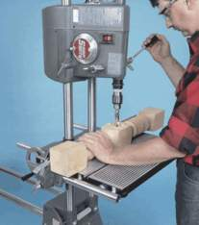
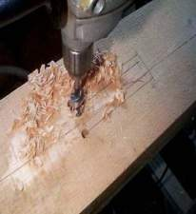
9. Eliminate wasted machine cycle time
Sketch and Evaluate Alternatives
Switch on drill press
Air cutting down (Muda)
Drilling
Air cutting up (Muda)
Only the hole is value added
Design out 'air cutting' and minimize machine movements

Slide 72
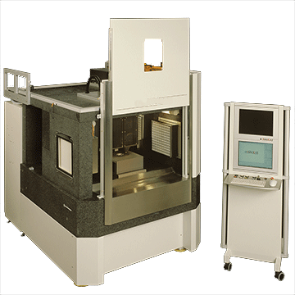
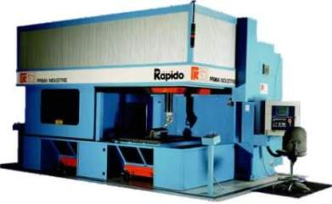
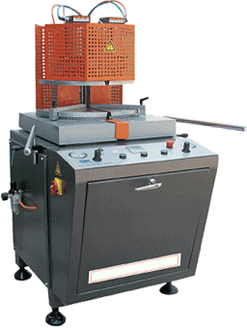

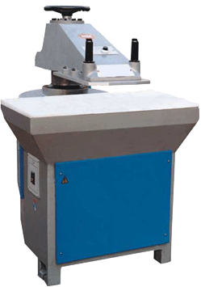
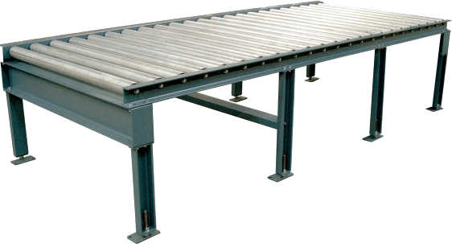
10. Build equipment for small swift flow lines
Sketch and Evaluate Alternatives
Enable Standard Work (Takt, Work Sequence, SWIP)
Notes:
SAY: “These two lines perform the same functions. The right hand line can be moved, rearranged, flexibly manned and reused for other product lines if required.”

Slide 73
11. Use short, vertical flow lines
Sketch and Evaluate Alternatives
Forming
Inspect
Inspect
Machine
Machining
Inspection
Machine
Form
Weld
Welding
Stores
Weld
Weld
Form
Paint
Assemble
Paint
Assembly
Assemble
Paint
Assemble
Painting
Store
Store
Store
Horizontal = functional
Vertical = advancing process flow

Slide 74




12. Build equipment for one-piece pull
Sketch and Evaluate Alternatives
Customer and supplier are not linked. Supplier pushes.
Customer and supplier are linked. Customer pulls.
Machine level flow. This is probably the most critical one.
Notes:
SAY: “The concept of push vs. pull is clear from the slide. Getting machines to do this is the trick. Machines must only produce when required and what is required, specified to be balanced for Takt time and flexible.”

Slide 75

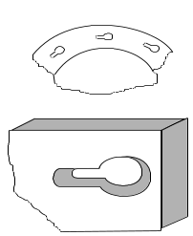
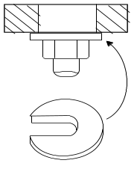

13. Build in quick changeover
Sketch and Evaluate Alternatives
5
4
A
3
1
2
3
4
Use programmable equipment for flexible set-ups
Minimise bolt lengths
Pear shape holes and ‘C’ washers for quick bold release
B
5
1
2
Flexible Cell Changes
b
a
a
Use stops or centering grooves to set positions
Use standard sizes
Design in the separation of internal and external tasks – SMED
Notes:
SAY: “This principle refers to making products and equipment that can be changed over quickly. Design products that are interchangeable, standard sizes so the machines do not need to be reset for each different component.
Use the principles of SMED to remove as much work as possible to be external to the machine cycle. Any work inside the cycle time is internal time.”

Slide 76
14. Link machines for smooth loading & unloading
Sketch and Evaluate Alternatives
Machines unlinked with variable WIP
Machines linked with standard WIP
Line stops when WIP on the line is "full work"
Notes:
SAY: “This is the concept called “Chaku Chaku” in Japanese, meaning “load load”. It is an efficient style of production in which all the machines needed to make a part are situated in the correct sequence very close together. Standard WIP, cycle times and operator work can be balanced.
The operator simply loads a part and moves on to the next operation. Each machine performs a different stage of production, such as turning, drilling, cleaning, testing or sandblasting.”

Slide 77
15. Use multiple lines & untangled flows
Sketch and Evaluate Alternatives
F1
A1
Model A
B1
Model B
F2
P1
Confusing Flow
A2
Model C
B2
F3
Model D
F4
A3
B = Blank F = Fabricate P = Paint A = Assembly
Model A
B1
F1
P1
A1
Model B
B2
F2
P2
A2
Rectified Flow
Model C
B3
F3
P3
A3
Model D
B4
F4
P4
A4
Use multiple and rectified flows

Slide 78

16. Spiral upwards to Jidoka
Sketch and Evaluate Alternatives
Jidoka
7 | Quality Check (Poka-Yoke)
6 | Part Removal (Hanedashi)
5 | Autonomation of Returns
4 | Automation of Stops
3 | Autonomation of Feed
2 | Automation of Holding
1 | Autonomation of processing
Take each step at a time, do not jump
Notes:
DO: See article/blog on The 5 Steps to Building Jidoka Equipment by Jon Miller.

Slide 79
Exercise: 16 Catch Phrases of 3P
Sketch and Evaluate Alternatives
Objective
Capture examples and non-examples of the 16 Catchphrases of 3P.
Instructions
Time to Complete
In small groups, utilize the 16 Catch Phrase Walk form on the following page to go to the gemba and find both examples and non-examples of the 16 Catch Phrases of 3P.
Take digital pictures, upload, and report-out.
60 minutes
Deliverable
Report out digital pictures to rest of class. Discuss key take-aways.

Slide 80
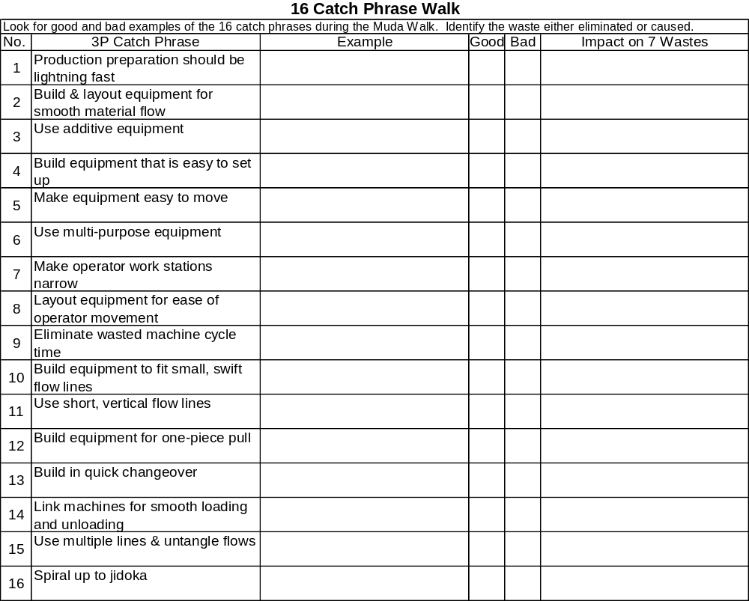
16 Catch Phrase Walk Form
Sketch and Evaluate Alternatives
1 form completed per pair/group
Use to identify both good and bad examples of the 16 Catch Phrases in the workplace

Slide 81
3P Design Evaluation Criteria
Needs
and Objectives
Examples
from Nature etc.
Sketch and
Evaluate
Alternatives
Prototype
Plan to
Implement
Objectives:
Understand importance to have the design “spec” early in the discovery process
Translate VOC, 3P data collection, stakeholder interviews in to requirements
Evaluate proposed requirements – must vs. want
List design requirements before generating alternatives
Come to group consensus
Notes:
DO: Review chapter objectives.
DO: Use the material captured in the Kick-off event if available.

Slide 82
Design Evaluation Criteria
Sketch and Evaluate Alternatives
Typical considerations:
Safety
Environmental
Critical customer requirements
Space or other physical limitations
Budget
Timeline urgencies
Product or process regulatory qualification requirements
(e.g. UL testing for consumer electronics, or PPAP for automotive)
Notes:
PPAP = Production Part Approval Process

Slide 83
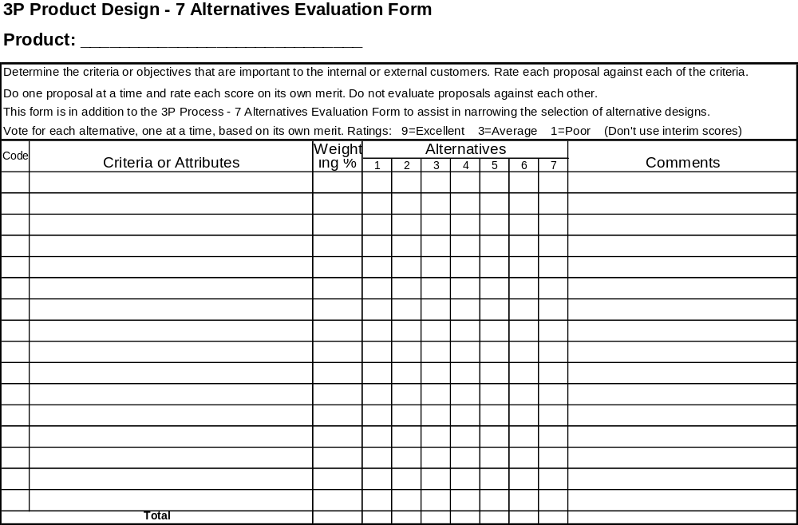
7 Alternatives Form: Product Design
Sketch and Evaluate Alternatives

Slide 84
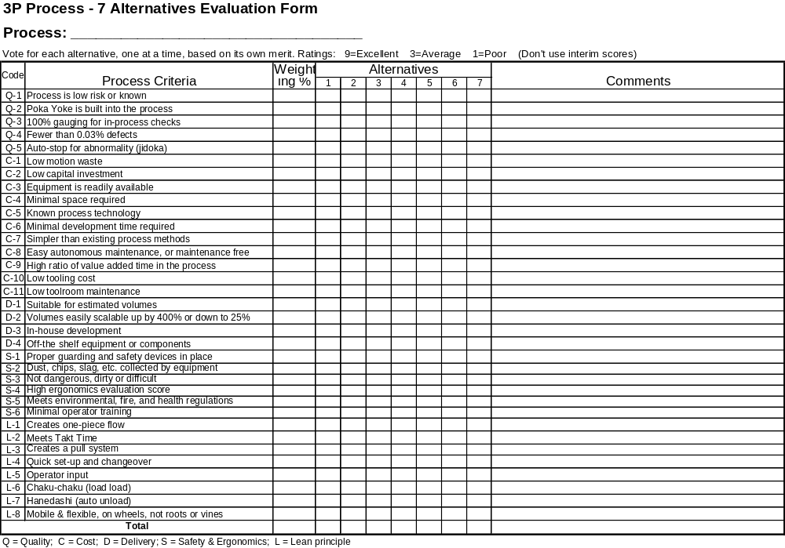
7 Alternatives Form: Process Design
Sketch and Evaluate Alternatives
Notes:
Toyota use checklists as a form of standard operation and as a training aid. This example is a composite extract from Toyota.

Slide 85
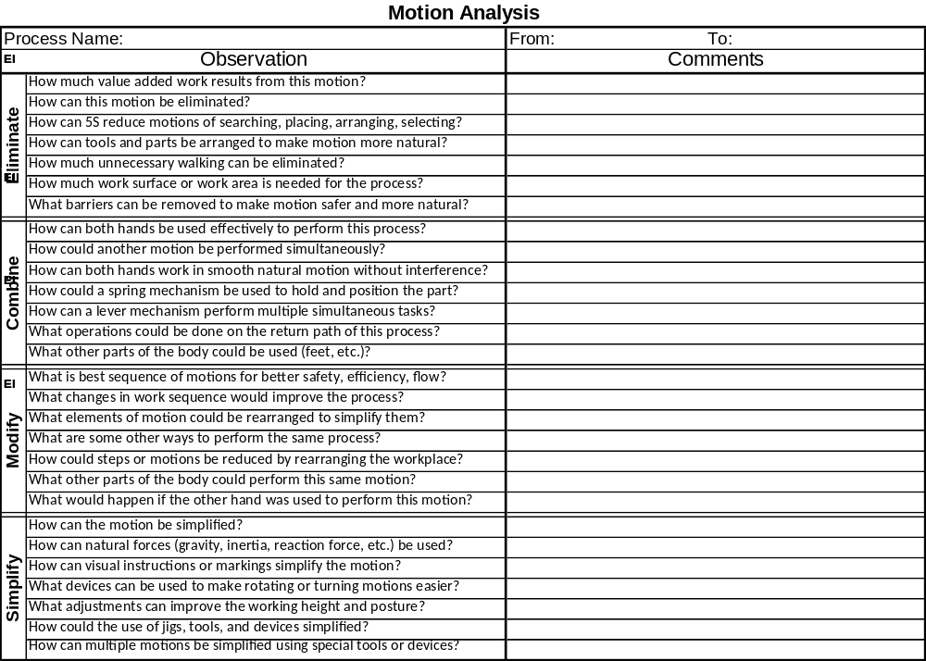
Use Motion Analysis to Assist Process Selection Criteria
Sketch and Evaluate Alternatives

Slide 86
Develop Weighting Criteria and Ranking System
Sketch and Evaluate Alternatives
Create the weighting criteria and ranking system to evaluate the 7 Alternatives
May need to include:
  VOC
  Industry Regulations
  Requirements identified from initial data collection, charter

Slide 87
Exercise: Design Evaluation Criteria
Sketch and Evaluate Alternatives
Objective
Establish the customer and technical requirements
Instructions
Time to Complete
As a group, identify at least 12 design requirements to help guide the creative process.
Don’t limit your thinking, just make sure all requirements are considered.
Come to group consensus by using a weighted decision matrix or multi-vote
30 minutes
Deliverable
List of critical design requirements

Slide 88
The 7 Alternatives
Needs
and Objectives
Examples
from Nature etc.
Sketch and
Evaluate
Alternatives
Prototype
Plan to
Implement
Objectives:
Create and draw the 7 Alternatives for each function
Review Lean Machine Checklist and modify to develop rating criteria for the 7 Alternatives
Rate each team member’s 7 Alternatives
Select final 7 Alternatives for the team
Complete the Process-At-A-Glance form for each of the 7 Alternatives
Present final 7 Alternatives
Notes:
DO: Review chapter objectives.

Slide 89
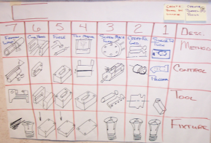
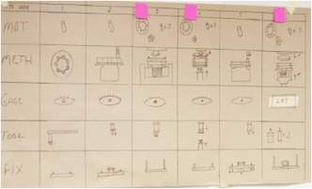
Create and Draw the 7 Alternatives for each function
Sketch and Evaluate Alternatives
The 7 Alternatives
Use the brainstorming results from the nature etc exercise as a source of inspiration to create the 7 Alternatives for each function
Each team member initially draws 7 Alternatives for each function

Slide 90
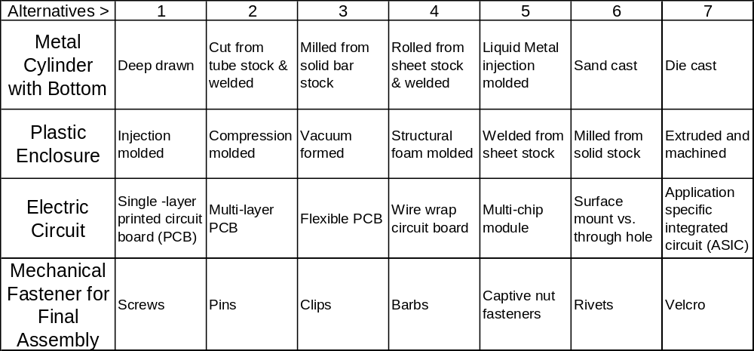
Example of Process Alternatives
Sketch and Evaluate Alternatives

Slide 91
Complete Process At A Glance for 7 Alternatives
Sketch and Evaluate Alternatives
Material – show the value-added step or transformation, “what changes?”
Method –show the function of the person’s hands, “what do they do?”
Gauge – show the device used to ensure 100% quality, “how do we measure”
Tool – show actual tool that does the processing, “what makes the product feature?”
Fixture – show how the work piece is held, “what holds the part?”

Slide 92
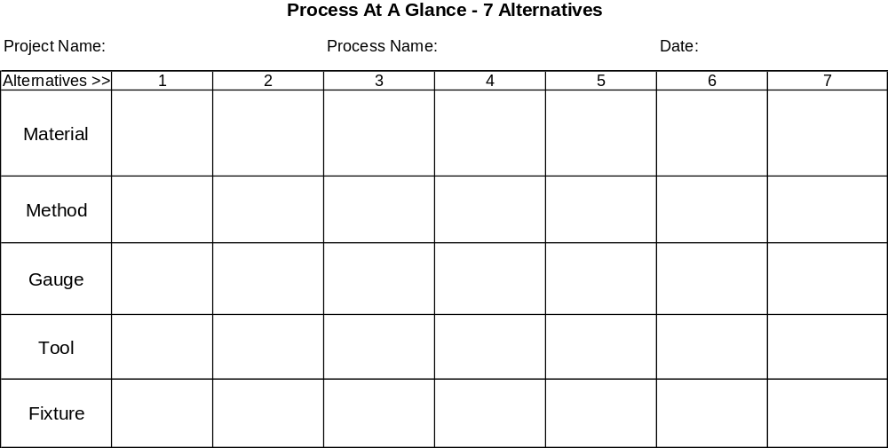
Process At A Glance Form
Sketch and Evaluate Alternatives

Slide 93
Exercise: 7 Alternatives
Sketch and Evaluate Alternatives
Objective
Create and evaluate the 7 Alternatives.
Instructions
Time to Complete
In the sub-teams, complete the following activities:
Each team member brainstorms and draws 7 Alternatives
As a sub-team develop rating criteria and ranking system for 7 Alternatives
Rate and rank each idea
Select Top 7 Alternatives
Complete Process-At-A-Glance Form for 7 Alternatives
Provided by facilitator
Deliverable
Report out the final 7 Alternatives

Slide 94
Selecting the Top 2-3 Alternatives
Needs
and Objectives
Examples
from Nature etc.
Sketch and
Evaluate
Alternatives
Prototype
Plan to
Implement
Objectives:
“Trystorm” each of the 7 Alternatives for each function
Review Lean Machine Checklist and modify to develop rating criteria to determine the Top 2-3 Alternatives
Rate each prototype
Select Top 2-3 Alternatives
Refine the Process-At-A-Glance form for each of Top 2-3 Alternatives
Present Top 2-3 Alternatives
Notes:
DO: Review chapter objectives.

Slide 95
“Trystorming” Process
Prototype
Like it sounds, Trystorming is a hands-on extension of brainstorming
Old adage, “If at first you don’t succeed, try, try, again.”
Trystorming is different from brainstorming in that it encourages the rapid development and test of an idea rather than merely thinking about the possible solutions.
Build up through multiple cycles: sketch, scale model (in clay or balsa wood), full scale – evaluating and adjusting (tweaking)

Slide 96
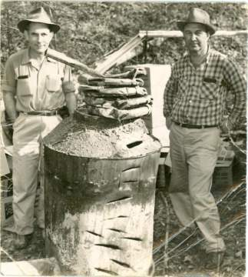
Sometimes called “Moonshining”
Prototype
Not conventional thinking
Many people will not like it
You may have to keep it a secret from your own organization - “skunk works”
May feel uncomfortable until people come to accept it

Slide 97
Lean Process Machine Checklist
Prototype
Q-1 Process is low risk or known
Q-2 Poka Yoke is built into the process
Q-3 100% gauging for in-process checks
Q-4 Fewer than 0.03% defects
Q-5 Auto-stop for abnormality (jidoka)
C-1 Low motion waste
C-2 Low capital investment
C-3 Equipment is readily available
C-4 Minimal space required
C-5 Known process technology
C-6 Minimal development time required
C-7 Simpler than existing process methods
C-8 Easy autonomous maintenance, or maintenance free
C-9 High ratio of value-added time in the process
C-10 Low tooling cost
C-11 Low toolroom maintenance
D-1 Suitable for estimated volumes
D-2 Volumes easily scalable up by 400% or down to 25%
D-3 In-house development
D-4 Off-the shelf equipment or components
S-1 Proper guarding and safety devices in place
S-2 Dust, chips, slag, etc. collected by equipment
S-3 Not dangerous, dirty or difficult
S-4 High ergonomics evaluation score
S-5 Meets environmental, fire, and health regulations
S-6 Minimal operator training
L-1 Creates one-piece flow
L-2 Meets Takt Time
L-3 Creates a pull system
L-4 Quick set-up and changeover
L-5 Operator input
L-6 Chaku-chaku (load load)
L-7 Hanedashi (auto unload)
L-8 Mobile & flexible, on wheels, not roots or vines

Slide 98
Exercise: Top 2-3 Alternatives
Prototype
Objective
Complete process to down select to top 2-3 Alternatives.
Instructions
Time to Complete
In the sub-teams, complete the following activities:
Sub-team creates prototypes for each of the 7 Alternatives
As a sub-team develop rating criteria and ranking system for Top 2-3 Alternatives
Rate and rank each prototype
Select Top 2-3 Alternatives
Refine Process-At-A-Glance for Top 2-3 Alternatives
Provided by facilitator
Deliverable
Report out the Top 2-3 Alternatives

Slide 99
Selecting the Top Alternative
Needs
and Objectives
Examples
from Nature etc.
Sketch and
Evaluate
Alternatives
Prototype
Plan to
Implement
Objectives:
Continue to refine “trystorming” prototypes
Combine with other sub-teams as needed to combine ideas to create final result
Refine final Alternative and Process-At-A-Glance Form
Notes:
DO: Review chapter objectives.

Slide 100
Exercise: Creating the Top Alternative
Prototype
Objective
Complete process to down select to Top Alternative.
Instructions
Time to Complete
In the sub-teams, complete the following activities:
Sub-team refines prototypes for top 2-3 Alternatives
Complete rating and ranking of prototypes
Combine with other sub-teams as needed to create the Top Alternative
Complete final prototype and Process At A Glance Form
Report-out to other sub-teams
Provided by facilitator
Deliverable
Report out on the Final 1 Alternative to other sub-teams

Slide 101
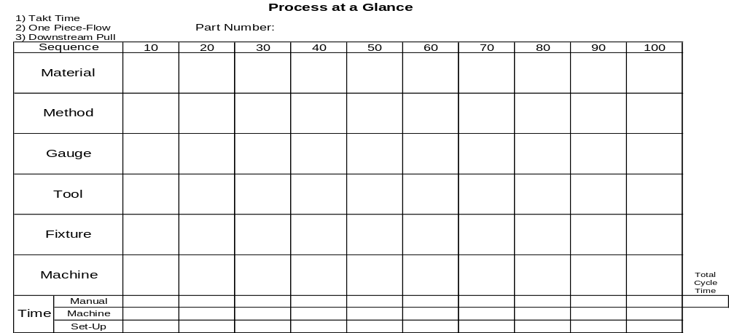
Process At A Glance Form
Prototype

Slide 102
3P Implementation Plan
Needs
and Objectives
Examples
from Nature etc.
Sketch and
Evaluate
Alternatives
Prototype
Plan to
Implement
Objectives:
Create project plan
Create concepts and shop drawings for fixtures and tooling
Prepare key elements of Implementation Plan
Prepare final report-out for 3P Event
Notes:
DO: Review chapter objectives.

Slide 103
3P Process
Plan to Implement
13 – Team refines Top Alternative. | 14 – Team completes Process At A Glance form for Top Alternative | 15 – Team prepares Implementation Plan.
16 – Present to Leadership. | 17 – Select builder & prepare fixture and tooling drawings. | 18 – Install, qualify, ramp up.
Key Actions

Slide 104
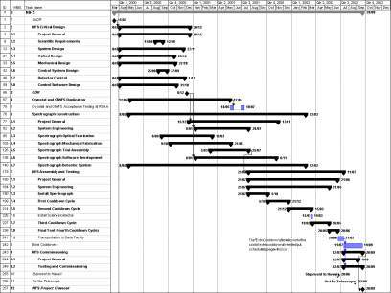
Create Project Plan
Plan to Implement
Develop Work Breakdown Structure
Estimate effort (direct work), duration (lapse time)
Resource list and availability
Sequence
Dependencies
Track deliverables & costs

Slide 105
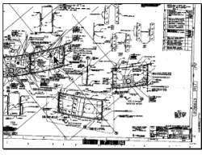
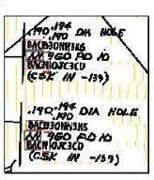
Create concepts and shop drawings for fixtures and tooling
Plan to Implement
Full Scale Top Design Prototype was built without engineering drawings, just paper and pencil sketches - now create drawings that capture the design intent
Clearly indicate key functions, tolerances, measurement points

Slide 106
Prepare Key Elements of Implementation Plan
Plan to Implement
High level estimates and sequence of events following approval of the 3P Design
Steps:
  Design detail: tooling and fixture engineering drawings
  Equipment Plans: builder selection, acceptance criteria
  Support Systems: material handling, maintenance, information systems
  Installation: samples, qualification, standard work
  Startup: training, daily management

Slide 107
Prepare Final Report Out and Budget
Plan to Implement
Charter
Objectives
Top Design Metrics
Implementation Plan
Benefits Summary

Slide 108
Other Modules In This Series:
5S
Standard Work
Total Productive Maintenance (TPM)
Administrative Lean
Cell Design/ Production Preparation Process (3P)
Kaizen
Kanban
Problem Solving
Poka Yoke Quality Systems
Transaction Process Improvement (TPI)
Cause & Effect Diagram with the Additions of Cards (CEDAC)
Single Minute Exchange of Dies (SMED)
Value Stream Mapping (VSMi®)
Visual Management
Managing Daily Process Excellence
For More Information Please Contact:
Mark DeLuzio, President and CEO
+1.860.234.0915
mark.deluzio@leanhorizons.com
Strategically Creating Value Through the Elimination of Waste

